Slide 1
St. James Health System Proposal
Asha Awil, Aimee Ramos, Shreyash

Slide 2
Table of contents
01
04
02
05
03
06
Situational Analysis
Measurement & Analysis
HRO Transformation
Change Management
Safety Culture Framework
Timeline and Funding

Slide 3

01
Situational Analysis

Slide 4
Overview of Current State
St. James runs several hospitals and clinics with heavy patient volume.
Recent issues include medication errors, falls, and surgical complications.
Staff highlight poor communication and unclear accountability.

Slide 5
Key Problems Identified
No consistent procedures across units.
Fear of reporting mistakes or near-misses.
Limited leadership visibility in safety efforts.
Outdated or inefficient reporting systems.

Slide 6
Why This Matters
Patient harm and loss of trust.
Regulatory pressure from CMS and Joint Commission.
Reputational damage that affects community confidence and staff morale.
Financial harm due to penalties, lawsuits, regulatory fines, and operational inefficiencies.
Financial impact from penalties, lawsuits, and inefficiencies.

Slide 7
Achieving Zero Defects
Implementation and operationalization of High Reliability Principles.
Implementation of a change management plan.
Design of reliable and error-resistant systems.
Establishment and implementation of a Just Culture.

Slide 8

02
HRO Transformation

Slide 9
What is an HRO
Organizations that operate in high-risk environments but maintain exceptionally low error rates.
Focused on reliability, resilience, and consistent performance despite complexity.

Slide 10
Why St. James Needs HRO Transformation
High number of preventable incidents shows the need for a structured safety overhaul.
Helps build a culture where staff report errors early and leadership responds quickly.

Slide 11
Key HRO Principles We Will Implement
Preoccupation with failure: Assume risks exist even when things seem normal.
Reluctance to simplify: Investigate root causes instead of assigning blame.
Sensitivity to operations: Leadership stays connected with frontline staff.
Commitment to resilience: Ability to recover quickly from unexpected events.
Deference to expertise: Allow trained staff to make safety decisions regardless of seniority.

Slide 12
Expected Benefits
Reduction in preventable harm.
More transparent and supportive culture.
System-wide consistency in safety practices.

Slide 13

03
Safety Culture Framework

Slide 14
Just Culture: Why St. James Needs It
St. James has experienced significant incidents and safety violations, such as bodily injury, death, and psychological harm.
These outcomes indicate a punitive or inconsistent safety environment where staff may fear reporting errors.
Fear suppresses reporting, allowing latent system failures to remain hidden.
A Just Culture framework is required to rebuild trust, promote transparency, and encourage early detection of deviations.
Creating a predictable and fair accountability structure is essential to rebuilding safety.

Slide 15
Just Culture Implementation
Implement a non-punitive reporting policy.
  Encourages staff engagement and and protects against reprisal.
Annual safe-reporting training
  Staff must have the training, resources, and support needed to meet safety expectations.
Standardized accountability and investigation procedures.
  Clear protocol on safety incident evaluation to ensure fairness and consistency.
Adopt a transparent communication and disclosure policy.
  Information about incidents, risks, and improvements is shared openly.

Slide 16
Leadership Practices
Leaders must demonstrate visible, sustained commitment to safety.
  Daily executive and departmental rounding to identify hazards, listen to staff concerns, and reinforce expectations.
Implement tiered safety huddles support real-time situational awareness across units, hospitals, and the system.
  Unit-Level: Immediate safety concerns, staffing issues, equipment needs.
  Hospital-Level: Escalated risks, resource coordination, performance updates.
  System-Level: Organization wide trends and high-priority risk mitigation.

Slide 17
Redundancy Layers
Additional standardized communication tools for healthcare teams.
Situation, Background, Assessment, Recommendation (SBAR): For communication relating to patient’s condition.
  Creates structure and predictability.
Read-back/Repeat-back: For verbal orders and handoffs.
  Limits potential errors.
Structured handoffs: For every transition of care.
  Ensures continuity of care
Pre-procedure/Post-procedure briefings
  Aligns expectations and identifies areas for improvement.

Slide 18
Redundancy Layers: Red Rules
Implementing Red Rules for high-risk processes where deviation can cause severe harm.
Common Red Rules:
Time-outs before any surgical or invasive procedure.
Verifying patient identity using two approved identifiers.
Bedside specimen labeling.
Surgical instrument and sponge counts.
Every staff member has the authority and responsibility to stop.
Reinforces shared ownership of safety and prevents catastrophic failures.

Slide 19

04
Measurement & Analysis

Slide 20
Safety Measurement System
Centralized, real-time, user friendly reporting system that is accessible across all hospitals and clinics.
Standardized event classification and process workflow. Staff will be provided training on what to report, how to report, and expectations.
High priority incidents are automatically escalated to leadership for review.
Captures essential information such as:
Patient safety scorecard
Near misses, drifts, and deviations
Active failures
Unsafe working conditions, equipment malfunctions, etc.

Slide 21

Patient Safety Scorecard
System-wide dashboard to track progress towards lag and lead measures.
Outcome (Lag) Measures: Reflect harm that has already occurred.
  AHRQ Patient Safety Indicators (PSIs): number of incidents per patient days (1,000) or procedures.
    e.g., falls, postoperative sepsis, or retained surgical item
  Serious Safety Event Rate (SSER): events per 10,000 patient days.
  CLABSI, CAUTI, C. difficile, serious medication errors.
Process (Lead) Measures: Track adherence to staff compliance and safety practices for detailed view of performance.

Slide 22
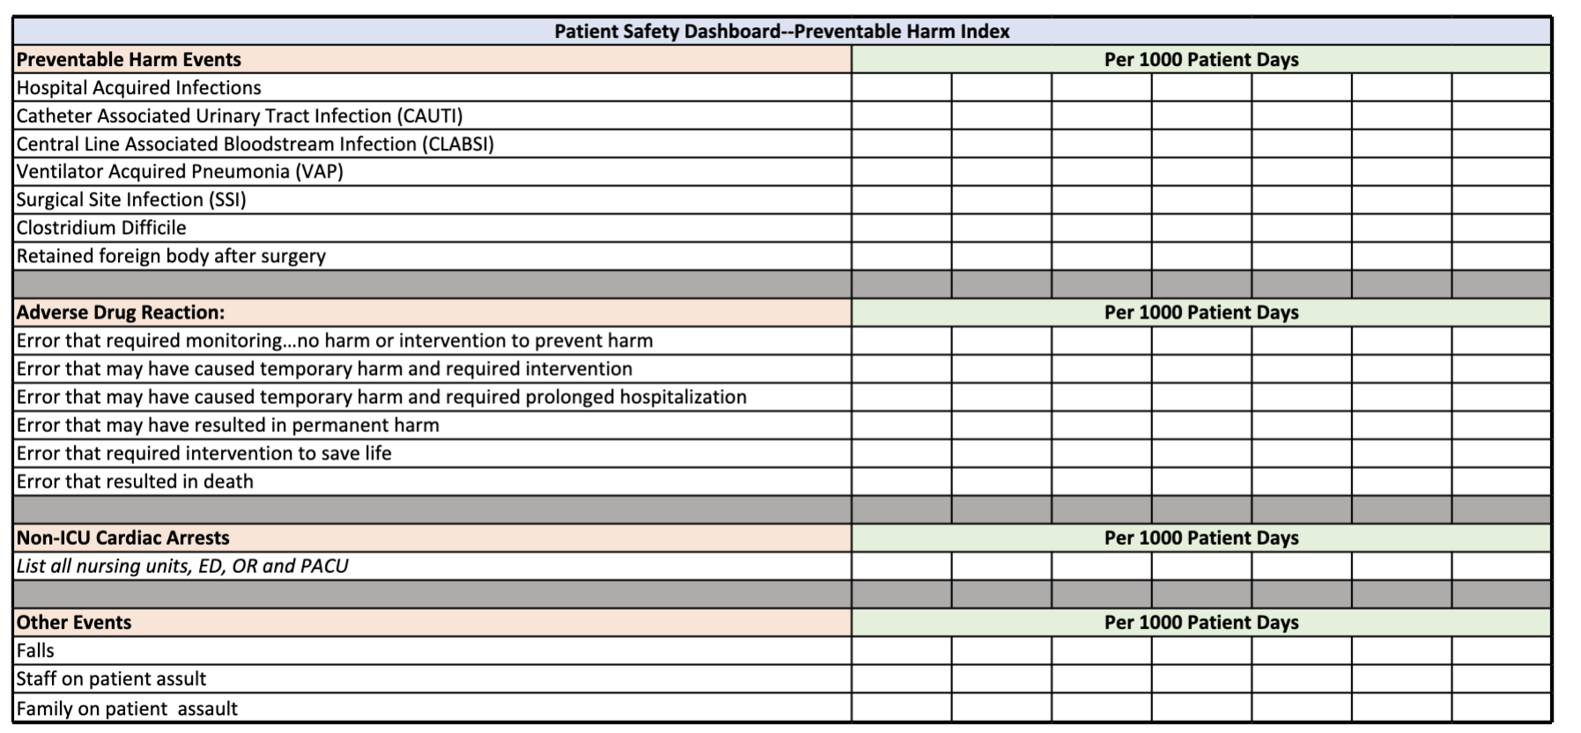
Patient Safety Scorecard

Slide 23
Retrospective Analysis
Root Cause Analysis (RCA) examines system factors behind active failures. Used to understand why failures occurred and prevent recurrence.
Ishikawa (Fishbone) Diagram: Analyzes people, processes, training, environment, technology, and culture.
5 Whys: Drills down to the underlying cause by repeatedly asking "why."
Pareto Chart: Identifies the small number of causes driving the majority of failures (80/20 rule).

Slide 24
Prospective Analysis
Identifies vulnerabilities before harm occurs through proactive analysis.
Gemba Observations
  Direct observation of staff performing real work in real settings.
  Reveals workflow complexity, workarounds, and latent conditions that increase risk.
Failure Modes and Effects Analysis (FMEA)
  Maps out high-risk processes step-by-step.
  Identifies where failures could occur and their potential impact.
  Prioritizes risks by severity and likelihood.

Slide 25

05
Change Management Plan

Slide 26
Change Management Plan
Provides structure and direction for systemwide change
Reduces resistance and builds staff engagement
Ensures clear communication and aligned expectations
Supports adoption of new behaviors and practices
Prevents regression and promotes long-term sustainability
Utilizes Kotters 8-step Model

Slide 27
Step 1: Create Urgency
Use real safety metrics as non-negotiable patient safety markers.
Leadership must emphasize the gravity in negative trends to patient safety.
Project how external pressure is putting employee jobs at risk.

Slide 28
Step 2: Establish a Guiding Coalition
Select high- credibility leaders across all care sites.
Ensure representation from each hospital and major clinic group to form the core group.
Define shared system-wide goals and expectations.
Define explicit roles, authority, and accountability.
Create a structured meeting schedule.

Slide 29
Step 3: Create a Clearer Vision
A concise and clear direction motivates people to act and helps define what success looks like.
“Zero harm, zero defects, and high reliability across all facilities.”

Slide 30
Step 4: Communicate the Vision
Persistent, structured communication helps eliminate mistrust, rumor-driven narratives, and resistance to cultural, organizational and social change.
Implement Daily safety meetings.
Implement leadership rounds.
Implement the use of daily shift reports.

Slide 31
Step 5: Staff Empowerment
Implement a simple, real-time issue-tracking system.
Place issue logs in every unit and require a resolution or resolution attempt within 72 hours.
Introduce a Just Culture.
Involve frontline staff in safety redesign.

Slide 32
Step 6: Generate Short-Term Wins
Show a significant improvement in CLABSI bundle adherence in one ICU within 1 month.
Expand to another ICU and reassess after 1 month.
Monthly reviews on how many daily reports are actually being submitted. An increase of at least 15% can be considered a win.

Slide 33
Step 7: Don’t Let Up
Maintain a relentless focus on improvement of key. metrics such as CLABSIs, falls, and near-miss reporting rates.
Constant reinforcement of expectations through leadership behavior.
Expansion of successful pilots system-wide.
Strengthening of accountability systems through quarterly reviews.

Slide 34
Step 8: Anchor Change
Make safety expectations clear during hiring, onboarding, and orientations.
Reinforce safety compliance through performance evaluations.
Prioritization and addressment of safety metrics in all committee and leadership meetings.
Integration of rewards for departments that show compliance and pressure for departments not showing steady improvements.

Slide 35

06
Timeline and Funding

Slide 36
Project Timeline
Phase 1:
Building the Foundation
Phase 2:
Strengthening Safety & Integrity
Phase 3:
Standardization & Measurable Results
Phase 4:
High Reliability and Zero-Defect Performance
Months 0-6
Establish Urgency, leadership alignment, and essential safety behaviors.
Months 6-18
Minimize variation and introduce reliability principles.
Months 18-36
Standardize safety practices into daily operations and achieve consistent, measurable improvements.
Months 36-60
Become a successful HRO and maintain zero-defect performance.

Slide 37
PHASE 1 (Months 0–6) — Building the Foundation
Budget Category | Description | Estimated Cost
Systemwide HRO training for all staff | Curriculum, workshops, onboarding modules | $1,200,000
Leadership alignment and coaching | Executive coaching, consultant support | $450,000
Just Culture introduction | Policy redesign, HR integration, safety communication rollout | $300,000
Safety meetings and rounding launch | Standardized rounding tools, scheduling infrastructure | $250,000
Process mapping and protocol simplification | Workflow redesign, hazard removal, lean facilitation team | $400,000
Guiding Coalition establishment | Protected time for clinical leads and quarterly reviews | $250,000
Phase 1 Total |  | $2,850,000

Slide 38
PHASE 2 (Months 6–18) — Strengthening Safety and Integrity
Budget Category | Description | Cost
Standardized clinical protocols systemwide | Policy development and implementation | $1,000,000
Hard-stop equipment workflows | Barcode verification, pump lockouts, med scanning | $800,000
FMEA and risk analysis program | Analyst team and risk modeling software | $600,000
Daily safety reporting system | Digital platform rollout and training | $950,000
Safety tracking and near-miss database | Data dashboards, reporting automation | $700,000
Phase 2 Total |  | $4,050,000

Slide 39
PHASE 3 (Months 18–36) — Standardization and Measurable Results
Budget Category | Description | Cost
Systemwide safety standardization | Unit checklists, universal protocols | $900,000
Leadership performance alignment | KPI incentives tied to reliability | $600,000
Data analytics for CLABSI, HAI, falls, med error reduction | Predictive analytics, dashboards | $1,200,000
Situational awareness and escalation training | Cognitive unloading, stop-the-line training | $650,000
Culture reinforcement programs | Safety recognition, reporting incentives | $450,000
Phase 3 Total |  | $3,800,000

Slide 40
PHASE 4 (Months 36–60) — High Reliability and Zero-Defect Performance
Budget Category | Description | Cost
Maintenance of HRO competency | Recertification, capability building | $900,000
Permanent rounding and event prevention team | Patient safety officers, HRO reliability leads | $1,200,000
Rapid issue resolution infrastructure | Escalation workcells, 72-hour closure requirement | $800,000
Annual external validation and benchmarking | AHRQ and HRO verification audit | $600,000
Phase 4 Total |  | $3,500,000

Slide 41
Zero-Defect Transformation (5-Year Plan)
Phase | Focus Area | Cost Estimate
Phase 1 (0–6 months) | Foundation, leadership alignment, HRO training, Just Culture rollout | $2.85M
Phase 2 (6–18 months) | Reliability infrastructure, protocol standardization, FMEA, safety reporting systems | $4.05M
Phase 3 (18–36 months) | Systemwide standardization, measurable safety improvements, analytics and outcome tracking | $3.80M
Phase 4 (36–60 months) | Zero-defect sustainment, rapid-response capability, certification and benchmarking | $3.50M
Project Total |  | $14.2M

Slide 42
Conclusion
Shift from reactive problem-solving to consistent, prevention-focused practices.
Strengthen psychological safety so staff feel comfortable speaking up.
Use fair accountability to support learning rather than blame.
Standardize communication (e.g., checklists, structured handoffs) to keep teams aligned.
Track measurable goals to monitor progress and reinforce reliability.
Maintain strong leadership involvement and frontline support.
Reduce daily operational risks and improve care quality across all sites.

Slide 43
Thanks for listening!
Any questions?

